Slide 1
Chapter 1 Computer System Overview
Operating Systems: Internals and Design Principles
Seventh Edition
By William Stallings
Notes:
“Operating Systems: Internal and Design Principles”, 7/e, by William Stallings, Chapter 1 “Computer System Overview”.

Slide 2
Operating Systems: Internals and Design Principles
“No artifact designed by man is so convenient for this kind of functional description as a digital computer. Almost the only ones of its properties that are detectable in its behavior are the organizational properties. Almost no interesting statement that one can make about on operating computer bears any particular relation to the specific nature of the hardware. A computer is an organization of elementary functional components in which, to a high approximation, only the function performed by those components is relevant to the behavior of the whole system.”
THE SCIENCES OF THE ARTIFICIAL ,
Herbert Simon
Notes:
Chapter 1 provides an overview of computer system hardware. In most areas, the survey is brief, as it is assumed that the reader is familiar with this subject. However, several areas are covered in some detail because of their importance to topics covered later in the book.

Slide 3
Operating System
Exploits the hardware resources of one or more processors
Provides a set of services to system users
Manages secondary memory and I/O devices
Notes:
An operating system (OS) exploits the hardware resources of one or more processors to provide a set of services to system users. The OS also manages secondary memory and I/O (input/output) devices on behalf of its users. Accordingly, it is important to have some understanding of the underlying computer system hardware before we begin our examination of operating systems.

Slide 4
Basic Elements
Processor
Main Memory
I/O Modules
System Bus
Notes:
At a top level, a computer consists of processor, memory, and I/O components, with one or more modules of each type. These components are interconnected in some
fashion to achieve the main function of the computer, which is to execute programs. Thus, there are four main structural elements:
Processor
I/O Modules
Main Memory
System Bus

Slide 5
Processor
Controls the operation of the computer
Performs the data processing functions
Referred to as the Central Processing Unit (CPU)
Notes:
Processor : Controls the operation of the computer and performs its data processing functions. When there is only one processor, it is often referred to as the central processing unit (CPU).

Slide 6
Main Memory
Volatile
Contents of the memory is lost when the computer is shut down
Referred to as real memory or primary memory
Notes:
Main memory : Stores data and programs. This memory is typically volatile; that is, when the computer is shut down, the contents of the memory are lost. In contrast, the contents of disk memory are retained even when the computer system is shut down. Main memory is also referred to as real memory or primary memory.

Slide 7
I/O Modules
Moves data between the computer and external environments such as:
storage (e.g. hard drive)
communications equipment
terminals
Notes:
I/O modules : Move data between the computer and its external environment. The external environment consists of a variety of devices, including secondary
memory devices (e.g., disks), communications equipment, and terminals.

Slide 8
System Bus
Provides for communication among processors, main memory, and I/O modules
Notes:
System bus : Provides for communication among processors, main memory, and I/O modules.

Slide 9
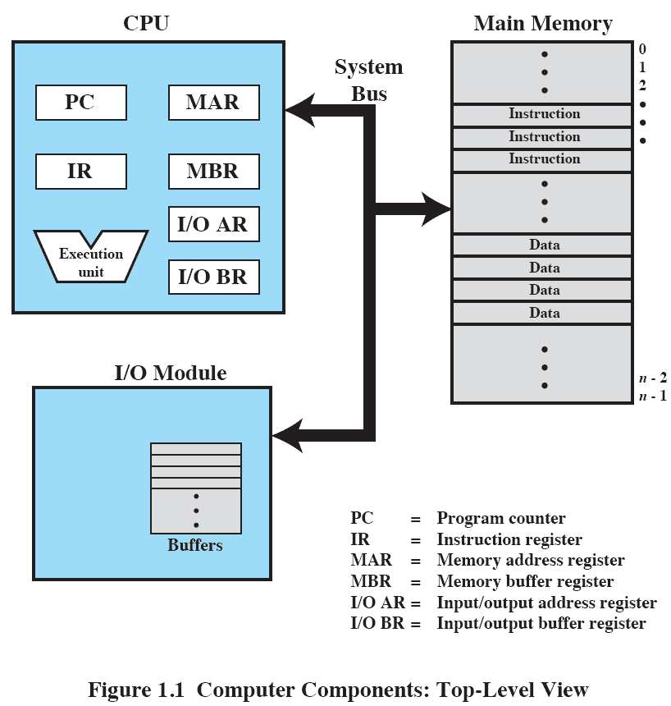
Top-Level View
Notes:
Figure 1.1 depicts these top-level components. One of the processor’s functions is to exchange data with memory. For this purpose, it typically makes use of two internal (to the processor) registers: a memory address register (MAR), which specifies the address in memory for the next read or write; and a memory buffer register (MBR), which contains the data to be written into memory or which receives the data read from memory. Similarly, an I/O address register (I/OAR) specifies a particular I/O device. An I/O buffer register (I/OBR) is used for the exchange of data between an I/O module and the processor.
A memory module consists of a set of locations, defined by sequentially numbered addresses. Each location contains a bit pattern that can be interpreted as either an instruction or data. An I/O module transfers data from external devices to processor and memory, and vice versa. It contains internal buffers for temporarily holding data until they can be sent on.

Slide 10
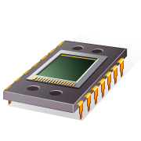
Microprocessor
Invention that brought about desktop and handheld computing
Processor on a single chip
Fastest general purpose processor
Multiprocessors
Each chip (socket) contains multiple processors (cores)
Notes:
The hardware revolution that brought about desktop and handheld computing was the invention of the microprocessor, which contained a processor on a single chip. Though originally much slower than multichip processors, microprocessors have continually evolved to the point that they are now much faster for most computations due to the physics involved in moving information around in sub-nanosecond timeframes.
Not only have microprocessors become the fastest general purpose processors available, they are now multiprocessors; each chip (called a socket) contains multiple processors (called cores), each with multiple levels of large memory caches, and multiple logical processors sharing the execution units of each core. As of 2010, it is not unusual for even a laptop to have 2 or 4 cores, each with 2 hardware threads, for a total of 4 or 8 logical processors.

Slide 11
Graphical Processing Units (GPU’s)
Provide efficient computation on arrays of data using Single-Instruction Multiple Data (SIMD) techniques
Used for general numerical processing
Physics simulations for games
Computations on large spreadsheets
G
P
U
Notes:
Although processors provide very good performance for most forms of computing, there is increasing demand for numerical computation. Graphical Processing Units (GPUs) provide efficient computation on arrays of data using Single-Instruction Multiple Data (SIMD) techniques pioneered in supercomputers. GPUs are no longer used just for rendering advanced graphics, but they are also used for general numerical processing, such as physics simulations for games or computations on large spreadsheets. Simultaneously, the CPUs themselves are gaining the capability of operating on arrays of data—with increasingly powerful vector units integrated into the processor architecture of the x86 and AMD64 families. Processors and GPUs are not the end of the computational story for the modern PC.

Slide 12
Digital Signal Processors (DSPs)
Deal with streaming signals such as audio or video
Used to be embedded in devices like modems
Encoding/decoding speech and video (codecs)
Support for encryption and security
D
S
P
Notes:
Digital Signal Processors (DSPs) are also present, for dealing with streaming signals—such as audio or video. DSPs used to be embedded in I/O devices, like modems, but they are now becoming first-class computational devices, especially in handhelds. Other specialized computational devices (fixed function units) co-exist with the CPU to support other standard computations, such as encoding/decoding speech and video (codecs), or providing support for encryption and security.

Slide 13

System on a Chip (SoC)
To satisfy the requirements of handheld devices, the microprocessor is giving way to the SoC
Components such as DSPs, GPUs, codecs and main memory, in addition to the CPUs and caches, are on the same chip
Notes:
To satisfy the requirements of handheld devices, the classic microprocessor is giving way to the System on a Chip (SoC), where not just the CPUs and caches are on the same chip, but also many of the other components of the system, such as DSPs, GPUs, I/O devices (such as radios and codecs), and main memory.

Slide 14
Instruction Execution
A program consists of a set of instructions stored in memory
Two steps:
processor reads (fetches) instructions from memory
processor executes each instruction
Notes:
A program to be executed by a processor consists of a set of instructions stored in memory. In its simplest form, instruction processing consists of two steps: The processor reads ( fetches ) instructions from memory one at a time and executes each instruction. Program execution consists of repeating the process of instruction fetch and instruction execution. Instruction execution may involve several operations and depends on the nature of the instruction.

Slide 15
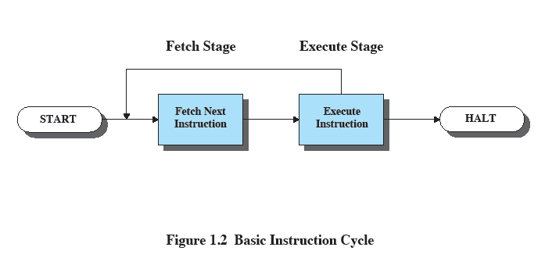
Basic Instruction Cycle
Notes:
The processing required for a single instruction is called an instruction cycle. Using a simplified two-step description, the instruction cycle is depicted in Figure 1.2 . The two steps are referred to as the fetch stage and the execute stage. Program execution halts only if the processor is turned off, some sort of unrecoverable error occurs, or a program instruction that halts the processor is encountered.

Slide 16
Instruction Fetch and Execute
The processor fetches the instruction from memory
Program counter (PC) holds address of the instruction to be fetched next
PC is incremented after each fetch
Notes:
At the beginning of each instruction cycle, the processor fetches an instruction from memory. Typically, the program counter (PC) holds the address of the next instruction to be fetched. Unless instructed otherwise, the processor always increments the PC after each instruction fetch so that it will fetch the next instruction in sequence (i.e., the instruction located at the next higher memory address).

Slide 17


Instruction Register (IR)
Fetched instruction is loaded into Instruction Register (IR)
Processor interprets the instruction and performs required action:
Processor-memory
Processor-I/O
Data processing
Control
Notes:
The fetched instruction is loaded into the instruction register (IR). The instruction contains bits that specify the action the processor is to take. The processor interprets the instruction and performs the required action. In general, these actions fall into four categories:
• Processor-memory: Data may be transferred from processor to memory or from memory to processor.
• Processor-I/O: Data may be transferred to or from a peripheral device by transferring between the processor and an I/O module.
• Data processing: The processor may perform some arithmetic or logic operation on data.
• Control: An instruction may specify that the sequence of execution be altered.
An instruction’s execution may involve a combination of these actions.

Slide 18
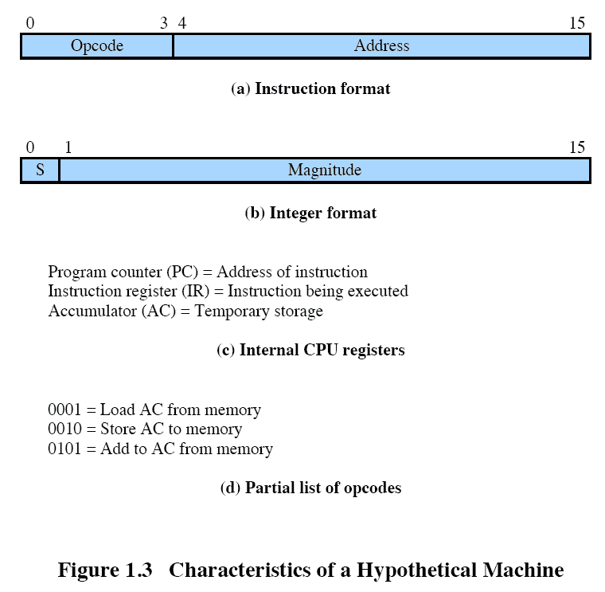
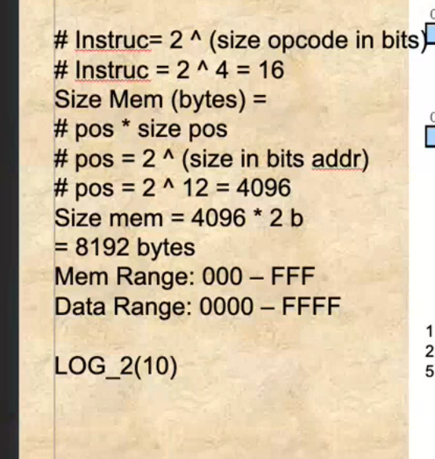
Characteristics of a Hypothetical Machine
Notes:
Consider a simple example using a hypothetical processor that includes the characteristics listed in Figure 1.3 . The processor contains a single data register, called the accumulator (AC). Both instructions and data are 16 bits long, and memory is organized as a sequence of 16-bit words. The instruction format provides 4 bits for the opcode, allowing as many as 24 16 different opcodes (represented by a single hexadecimal 1 digit). The opcode defines the operation the processor is to perform. With the remaining 12 bits of the instruction format, up to
212 4,096 (4K) words of memory (denoted by three hexadecimal digits) can be directly addressed.

Slide 19
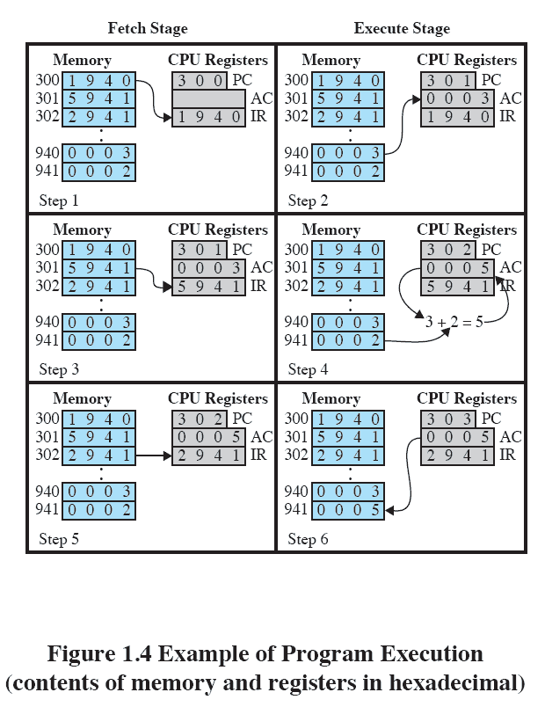
Example of Program Execution
Notes:
Figure 1.4 illustrates a partial program execution, showing the relevant portions of memory and processor registers. The program fragment shown adds the contents of the memory word at address 940 to the contents of the memory word at address 941 and stores the result in the latter location. Three instructions, which can be described as three fetch and three execute stages, are required:
The PC contains 300, the address of the first instruction. This instruction (the value 1940 in hexadecimal) is loaded into the IR and the PC is incremented. Note that this process involves the use of a memory address register (MAR) and a memory buffer register (MBR). For simplicity, these intermediate registers are not shown.
2. The first 4 bits (first hexadecimal digit) in the IR indicate that the AC is to be loaded from memory. The remaining 12 bits (three hexadecimal digits) specify the address, which is 940.
3. The next instruction (5941) is fetched from location 301 and the PC is incremented.
4. The old contents of the AC and the contents of location 941 are added and the result is stored in the AC.
5. The next instruction (2941) is fetched from location 302 and the PC is incremented.
6. The contents of the AC are stored in location 941.
In this example, three instruction cycles, each consisting of a fetch stage and
an execute stage, are needed to add the contents of location 940 to the contents
of 941. With a more complex set of instructions, fewer instruction cycles would be
needed. Most modern processors include instructions that contain more than one
address. Thus the execution stage for a particular instruction may involve more than
one reference to memory. Also, instead of memory references, an instruction may
specify an I/O operation.

Slide 20
Interrupts
Interrupt the normal sequencing of the processor
Provided to improve processor utilization
most I/O devices are slower than the processor
processor must pause to wait for device
wasteful use of the processor
Notes:
Virtually all computers provide a mechanism by which other modules (I/O, memory) may interrupt the normal sequencing of the processor.
Interrupts are provided primarily as a way to improve processor utilization. For example, most I/O devices are much slower than the processor. Suppose that the processor is transferring data to a printer using the instruction cycle scheme of Figure 1.2 . After each write operation, the processor must pause and remain idle until the printer catches up. The length of this pause may be on the order of many thousands or even millions of instruction cycles. Clearly, this is a very wasteful use of the processor.

Slide 21
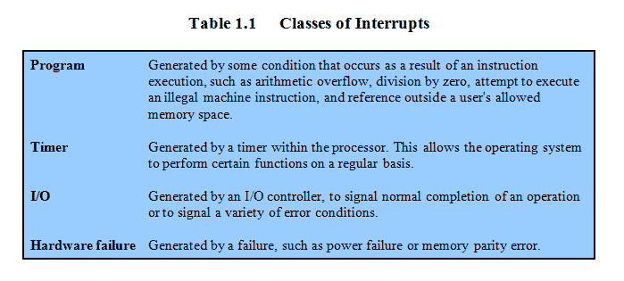
Common Classes of Interrupts
Notes:
Table 1.1 lists the most common classes of interrupts.

Slide 22
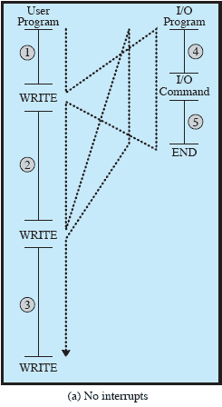
Flow of Control Without Interrupts
Notes:
To give a specific example, consider a PC that operates at 1 GHz, which would allow roughly 10 9 instructions per second. 2 A typical hard disk has a rotational speed of 7200 revolutions per minute for a half-track rotation time of 4 ms, which is 4 million times slower than the processor.
Figure 1.5a illustrates this state of affairs. The user program performs a series of WRITE calls interleaved with processing. The solid vertical lines represent segments of code in a program. Code segments 1, 2, and 3 refer to sequences of instructions that do not involve I/O. The WRITE calls are to an I/O routine that is a system utility and that will perform the actual I/O operation. The I/O program consists of three sections:
• A sequence of instructions, labeled 4 in the figure, to prepare for the actual I/O operation. This may include copying the data to be output into a special buffer and preparing the parameters for a device command.
• The actual I/O command. Without the use of interrupts, once this command is issued, the program must wait for the I/O device to perform the requested function (or periodically check the status, or poll, the I/O device). The program might wait by simply repeatedly performing a test operation to determine if the I/O operation is done.
• A sequence of instructions, labeled 5 in the figure, to complete the operation. This may include setting a flag indicating the success or failure of the operation. The dashed line represents the path of execution followed by the processor; that is, this line shows the sequence in which instructions are executed. Thus, after the first WRITE instruction is encountered, the user program is interrupted and execution continues with the I/O program. After the I/O program execution is complete, execution resumes in the user program immediately following the WRITE
Instruction. Because the I/O operation may take a relatively long time to complete, the I/O program is hung up waiting for the operation to complete; hence, the user program is stopped at the point of the WRITE call for some considerable period of time.

Slide 23
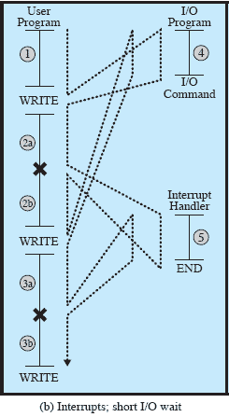
Interrupts: Short I/O Wait
Notes:
With interrupts, the processor can be engaged in executing other instructions while an I/O operation is in progress. Consider the flow of control in Figure 1.5b . As before, the user program reaches a point at which it makes a system call in the form of a WRITE call. The I/O program that is invoked in this case consists only of the preparation code and the actual I/O command. After these few instructions have been executed, control returns to the user program. Meanwhile, the external device is busy accepting data from computer memory and printing it. This I/O operation is conducted concurrently with the execution of instructions in the user program.
When the external device becomes ready to be serviced, that is, when it is ready to accept more data from the processor, the I/O module for that external device sends an interrupt request signal to the processor. The processor responds by suspending operation of the current program; branching off to a routine to service that particular I/O device, known as an interrupt handler; and resuming the original execution after the device is serviced. The points at which such interrupts occur are indicated by in Figure 1.5b . Note that an interrupt can occur at any point in the main program, not just at one specific instruction.

Slide 24
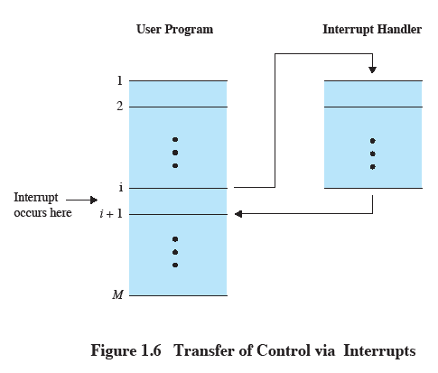
Transfer of Control via Interrupts
Notes:
For the user program, an interrupt suspends the normal sequence of execution. When the interrupt processing is completed, execution resumes ( Figure 1.6 ). Thus, the user program does not have to contain any special code to accommodate interrupts; the processor and the OS are responsible for suspending the user program and then resuming it at the same point.

Slide 25
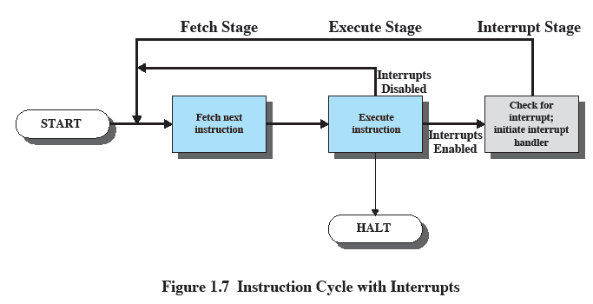
Instruction Cycle With Interrupts
Notes:
To accommodate interrupts, an interrupt stage is added to the instruction cycle, as shown in Figure 1.7 (compare Figure 1.2 ). In the interrupt stage, the processor checks to see if any interrupts have occurred, indicated by the presence of an interrupt signal. If no interrupts are pending, the processor proceeds to the fetch stage and fetches the next instruction of the current program. If an interrupt is pending, the processor suspends execution of the current program and executes an interrupthandler
routine. The interrupt-handler routine is generally part of the OS. Typically, this routine determines the nature of the interrupt and performs whatever actions are needed. In the example we have been using, the handler determines which I/O module generated the interrupt and may branch to a program that will write more data out to that I/O module. When the interrupt-handler routine is completed, the processor can resume execution of the user program at the point of interruption.
It is clear that there is some overhead involved in this process. Extra instructions must be executed (in the interrupt handler) to determine the nature of the interrupt and to decide on the appropriate action. Nevertheless, because of the relatively large amount of time that would be wasted by simply waiting on an I/O operation, the processor can be employed much more efficiently with the use of interrupts.

Slide 26
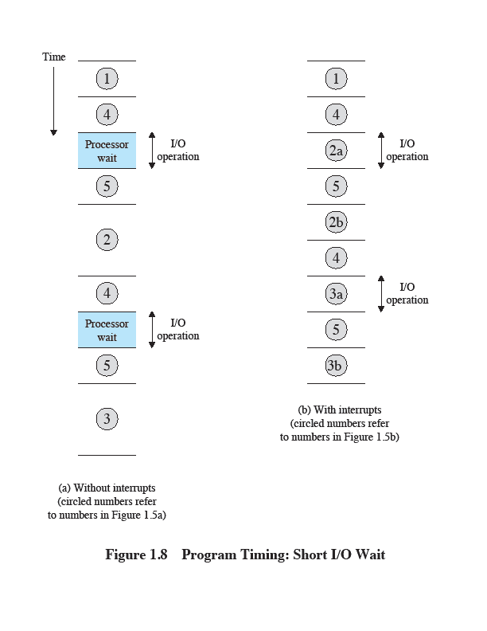
Program Timing: Short I/O Wait
Notes:
To appreciate the gain in efficiency, consider Figure 1.8 , which is a timing diagram based on the flow of control in Figures 1.5a and 1.5b . Figures 1.5b and 1.8 assume that the time required for the I/O operation is relatively short: less than the time to complete the execution of instructions between write operations in the user program. The more typical case, especially for a slow device such as a printer, is that the I/O operation will take much more time than executing a sequence of user instructions. Figure 1.5c indicates this state of affairs. In this case, the user program reaches the second WRITE call before the I/O operation spawned by the first call is complete. The result is that the user program is hung up at that point.

Slide 27
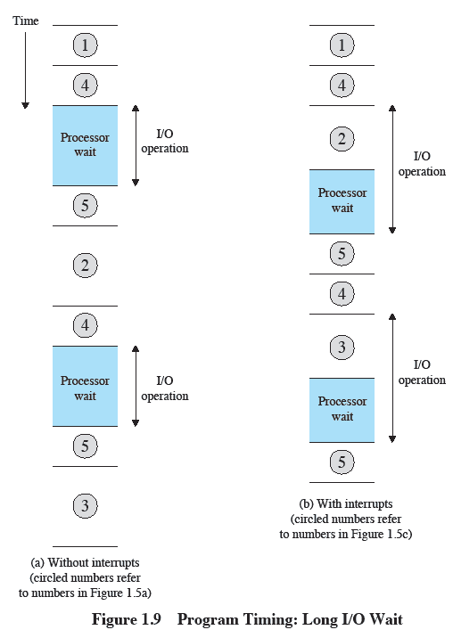
Program Timing: Long I/O wait
Notes:
When the preceding I/O operation is completed, this new WRITE call may be processed, and a new I/O operation may be started. Figure 1.9 shows the timing for this situation with
and without the use of interrupts. We can see that there is still a gain in efficiency because part of the time during which the I/O operation is underway overlaps with the execution of user instructions.

Slide 28
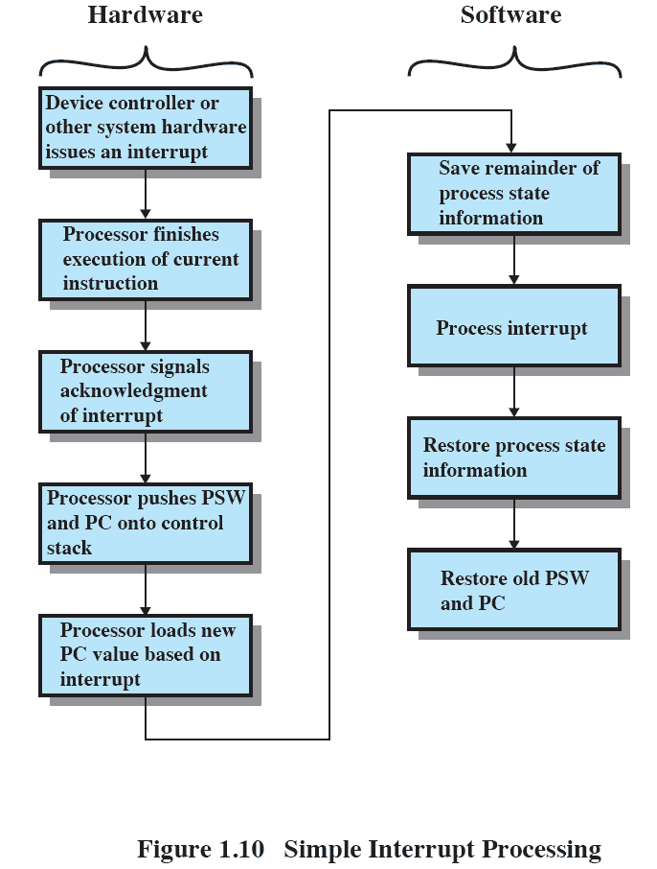
Simple Interrupt Processing
Notes:
An interrupt triggers a number of events, both in the processor hardware and in software. Figure 1.10 shows a typical sequence. When an I/O device completes an I/O operation, the following sequence of hardware events occurs:
The device issues an interrupt signal to the processor.
2. The processor finishes execution of the current instruction before responding to the interrupt, as indicated in Figure 1.7 .
3. The processor tests for a pending interrupt request, determines that there is one, and sends an acknowledgment signal to the device that issued the interrupt. The acknowledgment allows the device to remove its interrupt signal.
4. The processor next needs to prepare to transfer control to the interrupt routine. To begin, it saves information needed to resume the current program at the point of interrupt. The minimum information required is the program status word 3 (PSW) and the location of the next instruction to be executed, which is contained in the program counter (PC). These can be pushed onto a control stack (see Appendix 1B).
5. The processor then loads the program counter with the entry location of the interrupt-handling routine that will respond to this interrupt. Depending on the computer architecture and OS design, there may be a single program, one for each type of interrupt, or one for each device and each type of interrupt. If there is more than one interrupt-handling routine, the processor must determine which one to invoke. This information may have been included in the original interrupt signal, or the processor may have to issue a request to the device that issued the interrupt to get a response that contains the needed information.

Slide 29
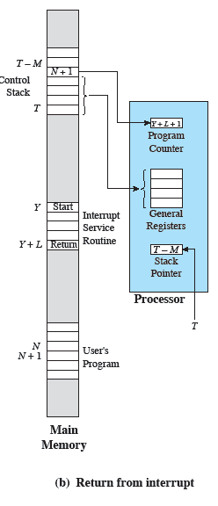
Changes for an Interrupt
Notes:
Once the program counter has been loaded, the processor proceeds to the next instruction cycle, which begins with an instruction fetch. Because the instruction fetch is determined by the contents of the program counter, control is transferred to the interrupt-handler program. The execution of this program results in the following operations:
6. At this point, the program counter and PSW relating to the interrupted program have been saved on the control stack. However, there is other information that is considered part of the state of the executing program. In particular, the contents of the processor registers need to be saved, because these registers may be used by the interrupt handler. So all of these values,
plus any other state information, need to be saved. Typically, the interrupt handler will begin by saving the contents of all registers on the stack. Other state information that must be saved is discussed in Chapter 3 . Figure 1.11a shows a simple example. In this case, a user program is interrupted after the instruction at location N. The contents of all of the registers plus the address of the next instruction (N 1) , a total of M words, are pushed onto the control stack. The stack pointer is updated to point to the new top of stack, and the program counter is updated to point to the beginning of the interrupt service routine.
7. The interrupt handler may now proceed to process the interrupt. This includes an examination of status information relating to the I/O operation or other event that caused an interrupt. It may also involve sending additional commands or acknowledgments to the I/O device.
8. When interrupt processing is complete, the saved register values are retrieved from the stack and restored to the registers (e.g., see Figure 1.11b ).
9. The final act is to restore the PSW and program counter values from the stack. As a result, the next instruction to be executed will be from the previously
interrupted program.
It is important to save all of the state information about the interrupted program for later resumption. This is because the interrupt is not a routine called from the program. Rather, the interrupt can occur at any time and therefore at any point in the execution of a user program. Its occurrence is unpredictable..

Slide 30
Multiple Interrupts
An interrupt occurs while another interrupt is being processed
e.g. receiving data from a communications line and printing results at the same time
Two approaches:
disable interrupts while an interrupt is being processed
use a priority scheme
Notes:
So far, we have discussed the occurrence of a single interrupt. Suppose, however, that one or more interrupts can occur while an interrupt is being processed. For example, a program may be receiving data from a communications line and printing results at the same time. The printer will generate an interrupt every time that it completes a print operation. The communication line controller will generate an interrupt every time a unit of data arrives. The unit could either be a single character or a block, depending on the nature of the communications discipline. In any case, it is possible for a communications interrupt to occur while a printer interrupt is being processed.

Slide 31
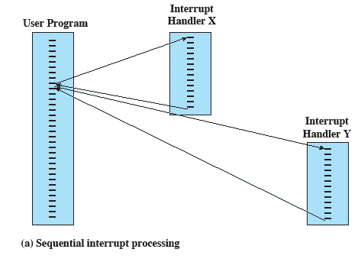
Transfer of Control With Multiple Interrupts:
Sequential
Notes:
Two approaches can be taken to dealing with multiple interrupts. The first is to disable interrupts while an interrupt is being processed. A disabled interrupt simply means that the processor ignores any new interrupt request signal. If an interrupt occurs during this time, it generally remains pending and will be checked by the processor after the processor has reenabled interrupts. Thus, if an interrupt occurs when a user program is executing, then interrupts are disabled immediately. After the interrupt-handler routine completes, interrupts are reenabled before resuming the user program, and the processor checks to see if additional interrupts have occurred. This approach is simple, as interrupts are handled in strict sequential
order ( Figure 1.12a ).

Slide 32
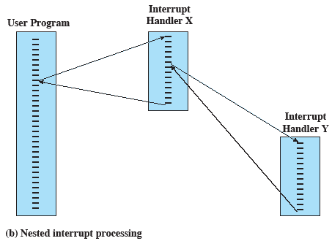
Transfer of Control With Multiple Interrupts:
Nested
Notes:
The drawback to the preceding approach is that it does not take into account relative priority or time-critical needs. For example, when input arrives from the communications line, it may need to be absorbed rapidly to make room for more input. If the first batch of input has not been processed before the second batch arrives, data may be lost because the buffer on the I/O device may fill and overflow.
A second approach is to define priorities for interrupts and to allow an interrupt of higher priority to cause a lower–priority interrupt handler to be interrupted ( Figure 1.12b ).

Slide 33
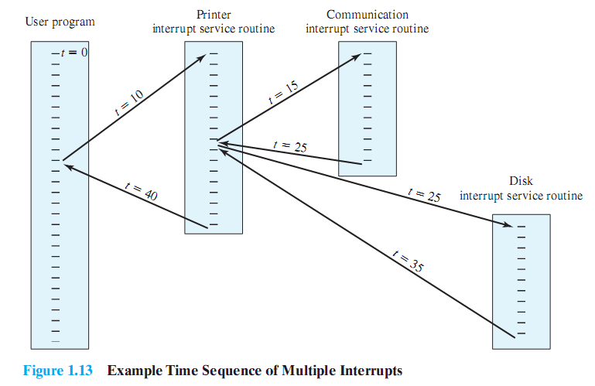
Example Time Sequence of Multiple Interrupts
Notes:
As an example of this second approach, consider a system with three I/O devices: a printer, a disk, and a communications line, with increasing priorities of 2, 4, and 5, respectively. Figure 1.13 , based on an example in [TANE06], illustrates a possible sequence. A user program begins at t 0 . At t 10 , a printer interrupt occurs; user information is placed on the control stack and execution continues at the printer interrupt service routine (ISR). While this routine is still executing, at t 15 a communications interrupt occurs. Because the communications line has
higher priority than the printer, the interrupt request is honored. The printer ISR is interrupted, its state is pushed onto the stack, and execution continues at the communications
ISR. While this routine is executing, a disk interrupt occurs (t 20) . Because this interrupt is of lower priority, it is simply held, and the communications ISR runs to completion.
When the communications ISR is complete (t 25) , the previous processor state is restored, which is the execution of the printer ISR. However, before even a single instruction in that routine can be executed, the processor honors the higherpriority disk interrupt and transfers control to the disk ISR. Only when that routine is complete (t 35) is the printer ISR resumed. When that routine completes (t 40) , control finally returns to the user program.

Slide 34
Memory Hierarchy
Major constraints in memory
amount
speed
expense
Memory must be able to keep up with the processor
Cost of memory must be reasonable in relationship to the other components
Notes:
The design constraints on a computer’s memory can be summed up by three questions: How much? How fast? How expensive?
The question of how much is somewhat open ended. If the capacity is there, applications will likely be developed to use it. The question of how fast is, in a sense, easier to answer. To achieve greatest performance, the memory must be able to keep up with the processor. That is, as the processor is executing instructions, we would not want it to have to pause waiting for instructions or operands. The final question must also be considered. For a practical system, the cost of memory must be reasonable in relationship to other components.

Slide 35
Memory Relationships
Faster access time = greater cost per bit
Greater capacity = smaller cost per bit
Greater capacity = slower access speed
Notes:
As might be expected, there is a trade-off among the three key characteristics of memory: namely, capacity, access time, and cost. A variety of technologies are used to implement memory systems, and across this spectrum of technologies, the following relationships hold:
• Faster access time, greater cost per bit
• Greater capacity, smaller cost per bit
• Greater capacity, slower access speed
The dilemma facing the designer is clear. The designer would like to use memory technologies that provide for large-capacity memory, both because the capacity is needed and because the cost per bit is low. However, to meet performance requirements, the designer needs to use expensive, relatively lower-capacity memories with fast access times.

Slide 36
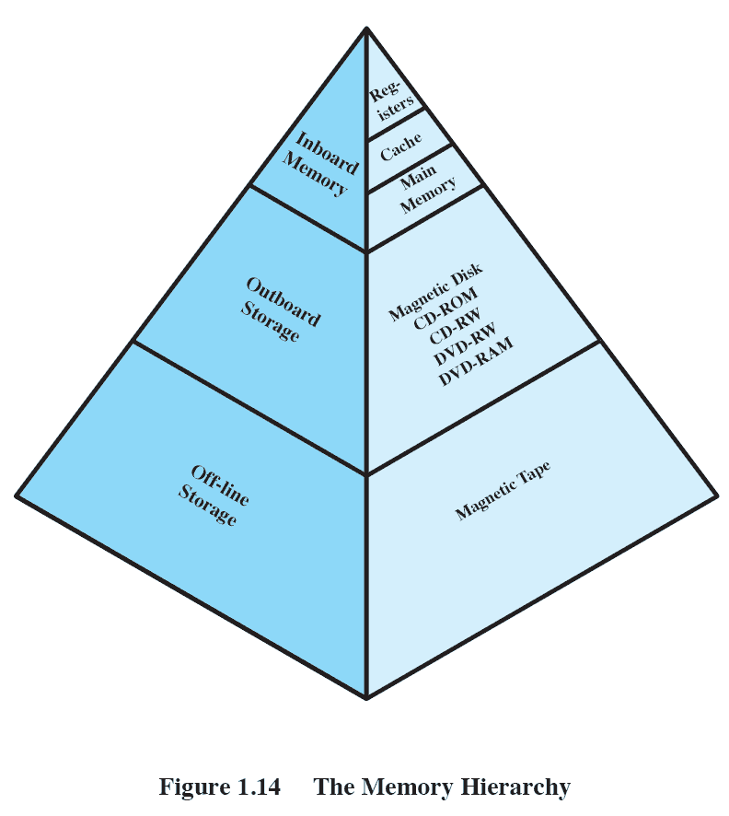
The Memory Hierarchy
Going down the hierarchy:
decreasing cost per bit
increasing capacity
increasing access time
decreasing frequency of access to the memory by the processor
Notes:
The way out of this dilemma is to not rely on a single memory component or technology, but to employ a memory hierarchy . A typical hierarchy is illustrated in
Figure 1.14 . As one goes down the hierarchy, the following occur:
a. Decreasing cost per bit
b. Increasing capacity
c. Increasing access time
d. Decreasing frequency of access to the memory by the processor
Thus, smaller, more expensive, faster memories are supplemented by larger, cheaper, slower memories. The key to the success of this organization is the decreasing
frequency of access at lower levels. We will examine this concept in greater detail later in this chapter, when we discuss the cache, and when we discuss virtual
memory later in this book. A brief explanation is provided at this point.
Suppose that the processor has access to two levels of memory. Level 1 contains 1,000 bytes and has an access time of 0.1 μs; level 2 contains 100,000 bytes and has an access time of 1 μs. Assume that if a byte to be accessed is in level 1, then the processor accesses it directly. If it is in level 2, then the byte is first transferred to level 1 and then accessed by the processor. For simplicity, we ignore the time required for the processor to determine whether the byte is in level 1 or level 2.

Slide 37
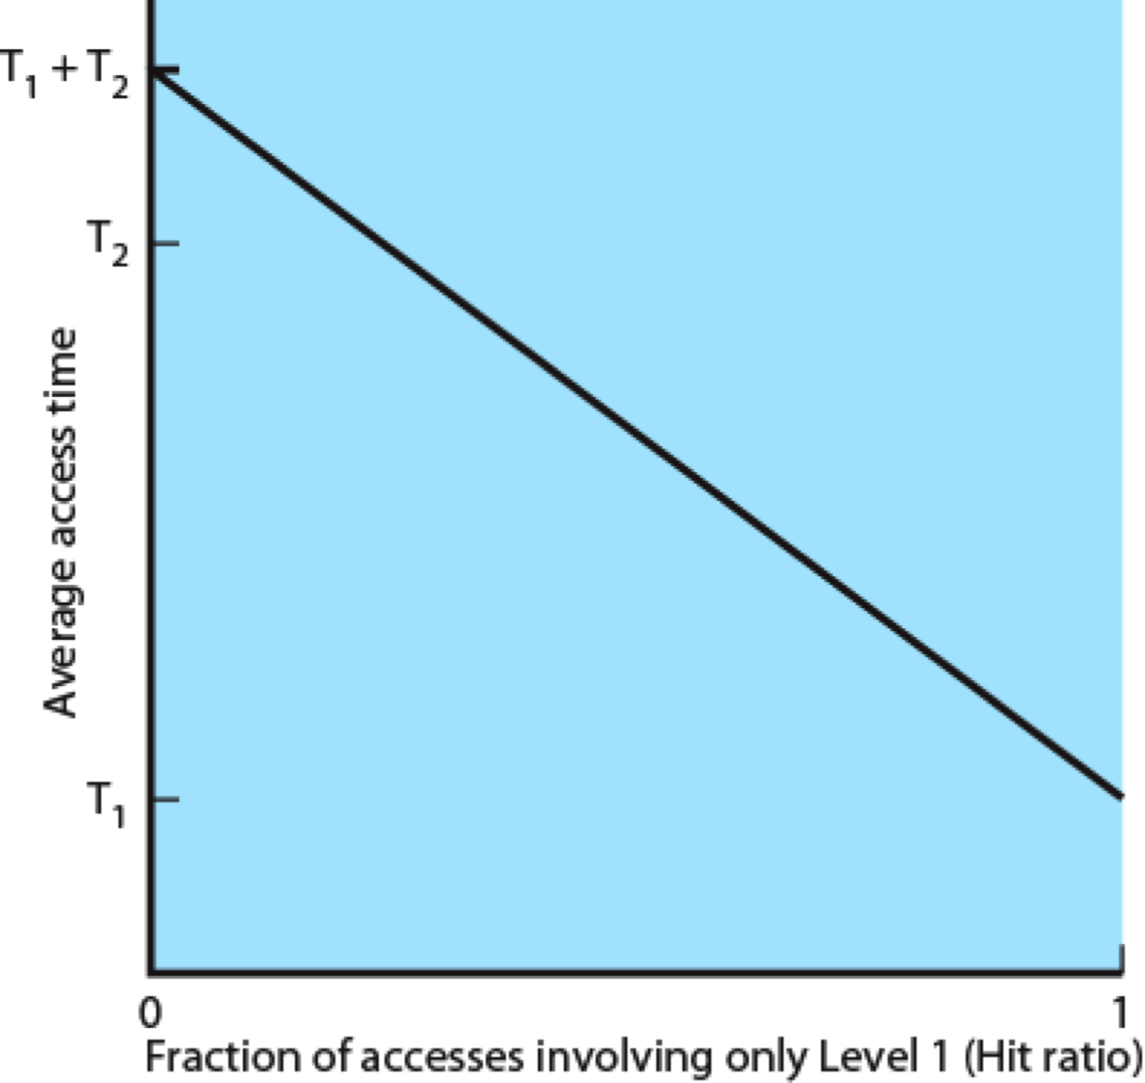
Performance of a Simple Two-Level Memory
Figure 1.15 Performance of a Simple Two-Level Memory
Notes:
Suppose that the processor has access to two levels of memory. Level 1 contains 1,000 bytes and has an access time of 0.1 μs; level 2 contains 100,000 bytes and has an access time of 1 μs. Assume that if a byte to be accessed is in level 1, then the processor accesses it directly. If it is in level 2, then the byte is first transferred to level 1 and then accessed by the processor. For simplicity, we ignore the time required for the processor to determine whether the byte is in level 1 or level 2.
Figure 1.15 shows the general shape of the curve that models this situation. The figure shows the average access time to a two-level memory as a function of the hit ratio H , where H is defined as the fraction of all memory accesses that are found in the faster memory (e.g., the cache), T 1 is the access time to level 1, and T 2 is the access time to level 2. 4 As can be seen, for high percentages of level 1 access, the average total access time is much closer to that of level 1 than that of level 2.
In our example, suppose 95% of the memory accesses are found in the cache (H 0.95) . Then the average time to access a byte can be expressed as
(0.95) (0.1 s) (0.05) (0.1 s 1 s) 0.095 0.055 0.15 s
The result is close to the access time of the faster memory. So the strategy of using two memory levels works in principle, but only if conditions (a) through (d) in the preceding list apply. By employing a variety of technologies, a spectrum of memory systems exists that satisfies conditions (a) through (c). Fortunately, condition (d) is also generally valid.

Slide 38
Principle of Locality
Memory references by the processor tend to cluster
Data is organized so that the percentage of accesses to each successively lower level is substantially less than that of the level above
Can be applied across more than two levels of memory
Notes:
The basis for the validity of condition (d) is a principle known as locality of reference [DENN68]. During the course of execution of a program, memory references by the processor, for both instructions and data, tend to cluster. Programs typically contain a number of iterative loops and subroutines. Once a loop or subroutine is entered, there are repeated references to a small set of instructions. Similarly, operations on tables and arrays involve access to a clustered set of data bytes. Over a long period of time, the clusters in use change, but over a short period of time, the processor is primarily working with fixed clusters of memory references. Accordingly, it is possible to organize data across the hierarchy such that the percentage of accesses to each successively lower level is substantially less than that of the level above. Consider the two-level example already presented. Let level 2 memory contain all program instructions and data. The current clusters can be temporarily placed in level 1. From time to time, one of the clusters in level 1 will have to be swapped back to level 2 to make room for a new cluster coming in to level 1. On average, however, most references will be to instructions and data contained in level 1. This principle can be applied across more than two levels of memory. The fastest, smallest, and most expensive type of memory consists of the registers internal to the processor. Typically, a processor will contain a few dozen such registers,
although some processors contain hundreds of registers. Skipping down two levels, main memory is the principal internal memory system of the computer. Each location in main memory has a unique address, and most machine instructions refer to one or more main memory addresses. Main memory is usually extended with a higher-speed, smaller cache. The cache is not usually visible to the programmer or, indeed, to the processor. It is a device for staging the movement of data between main memory and processor registers to improve performance.

Slide 39

Secondary Memory
Also referred to as auxiliary memory
External
Nonvolatile
Used to store program and data files
Notes:
The three forms of memory just described are, typically, volatile and employ semiconductor technology. The use of three levels exploits the fact that semiconductor memory comes in a variety of types, which differ in speed and cost. Data are stored more permanently on external mass storage devices, of which the most common are hard disk and removable media, such as removable disk, tape, and optical storage. External, nonvolatile memory is also referred to as secondary memory or auxiliary memory . These are used to store program and data files, and are usually visible to the programmer only in terms of files and records, as opposed to individual bytes or words. A hard disk is also used to provide an extension to main memory known as virtual memory, which is discussed in Chapter 8 .

Slide 40
Cache Memory
Invisible to the OS
Interacts with other memory management hardware
Processor must access memory at least once per instruction cycle
Processor execution is limited by memory cycle time
Exploit the principle of locality with a small, fast memory
Notes:
Although cache memory is invisible to the OS, it interacts with other memory management hardware. Furthermore, many of the principles used in virtual memory schemes (discussed in Chapter 8 ) are also applied in cache memory.
On all instruction cycles, the processor accesses memory at least once, to fetch the instruction, and often one or more additional times, to fetch operands and/ or store results. The rate at which the processor can execute instructions is clearly limited by the memory cycle time (the time it takes to read one word from or write one word to memory). This limitation has been a significant problem because of the persistent mismatch between processor and main memory speeds: Over the years, processor speed has consistently increased more rapidly than memory access speed. We are faced with a trade-off among speed, cost, and size. Ideally, main memory should be built with the same technology as that of the processor registers, giving memory cycle times comparable to processor cycle times. This has always been too expensive a strategy. The solution is to exploit the principle of locality by providing a small, fast memory between the processor and main memory, namely the cache.

Slide 41
Cache Principles
Contains a copy of a portion of main memory
Processor first checks cache
If not found, a block of memory is read into cache
Because of locality of reference, it is likely that many of the future memory references will be to other bytes in the block
Notes:
Cache memory is intended to provide memory access time approaching that of the fastest memories available and at the same time support a large memory size that has the price of less expensive types of semiconductor memories. The concept is illustrated in Figure 1.16a . There is a relatively large and slow main memory together with a smaller, faster cache memory. The cache contains a copy of a portion of main memory. When the processor attempts to read a byte or word of memory, a check is made to determine if the byte or word is in the cache. If so, the byte or word is delivered to the processor. If not, a block of main memory, consisting of some fixed number of bytes, is read into the cache and then the byte or word is delivered to
the processor. Because of the phenomenon of locality of reference, when a block of data is fetched into the cache to satisfy a single memory reference, it is likely that many of the near-future memory references will be to other bytes in the block.

Slide 42
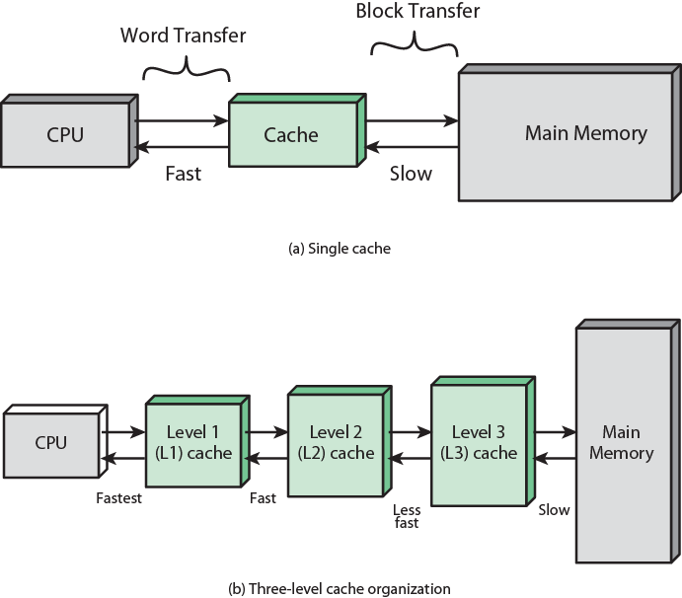
Cache and Main Memory
Notes:
Cache and main memory illustration.
Figure 1.16b depicts the use of multiple levels of cache. The L2 cache is slower and typically larger than the L1 cache, and the L3 cache is slower and typically larger than the L2 cache.

Slide 43
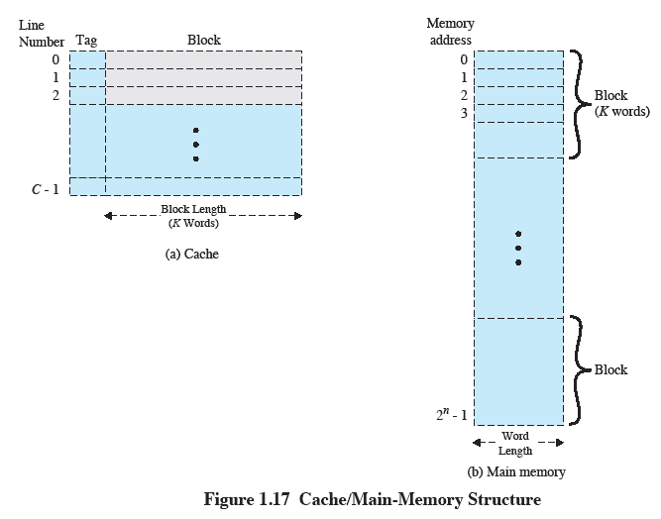
Cache/Main-Memory Structure
Notes:
Figure 1.17 depicts the structure of a cache/main memory system. Main memory consists of up to 2 n addressable words, with each word having a unique n –bit address. For mapping purposes, this memory is considered to consist of a number of fixed-length blocks of K words each. That is, there are M 2n/K blocks. Cache consists of C slots (also referred to as lines ) of K words each, and the number of slots is considerably less than the number of main memory blocks (CM) . 5 Some subset of the blocks of main memory resides in the slots of the cache. If a word in a block of memory that is not in the cache is read, that block is transferred to one of the slots of the cache. Because there are more blocks than slots, an individual slot cannot be uniquely and permanently dedicated to a particular block. Therefore, each slot includes a tag that identifies which particular block is currently being stored. The tag is usually some number of higher-order bits of the address and refers to all addresses that begin with that sequence of bits.

Slide 44
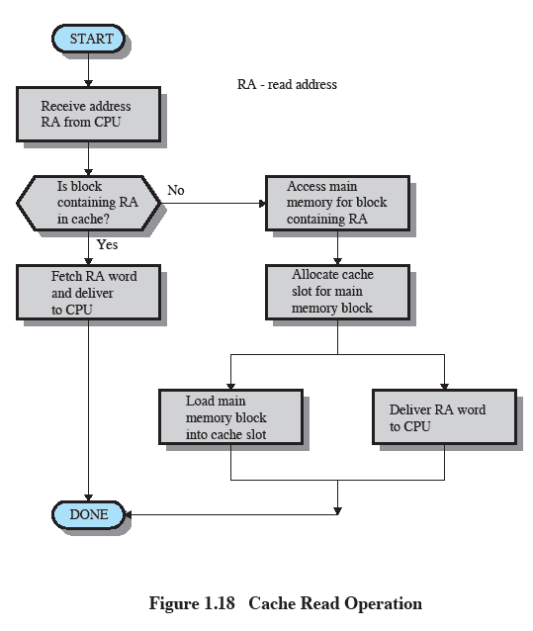
Cache Read Operation
Notes:
Figure 1.18 illustrates the read operation. The processor generates the address, RA, of a word to be read. If the word is contained in the cache, it is delivered to the processor. Otherwise, the block containing that word is loaded into the cache and the word is delivered to the processor.

Slide 45
Cache Design
Main categories are:
cache size
block size
mapping function
write policy
number of cache levels
replacement algorithm
Notes:
A detailed discussion of cache design is beyond the scope of this book. Key elements are briefly summarized here. We will see that similar design issues must be addressed in dealing with virtual memory and disk cache design. They fall into the following categories:
• Cache size
• Block size
• Mapping function
• Replacement algorithm
• Write policy
• Number of cache levels

Slide 46
Cache and Block Size
Cache Size
Small caches have significant impact on performance
Block Size
The unit of data exchanged between cache and main memory
Notes:
We have already dealt with the issue of cache size . It turns out that reasonably small caches can have a significant impact on performance. Another size issue is that of block size : the unit of data exchanged between cache and main memory. As the block size increases from very small to larger sizes, the hit ratio will at first increase because of the principle of locality: the high probability that data in the vicinity of a referenced word are likely to be referenced in the near future. As the block size increases, more useful data are brought into the cache. The hit ratio will begin to decrease, however, as the block becomes even bigger and the probability of using the newly fetched data becomes less than the probability of reusing the data that have to be moved out of the cache to make room for the new block.

Slide 47
Mapping Function
Determines which cache location the block will occupy
Two constraints affect design:
When one block is read in, another may have to be replaced
The more flexible the mapping function, the more complex is the circuitry required to search the cache
Notes:
When a new block of data is read into the cache, the mapping function determines which cache location the block will occupy. Two constraints affect the design of the mapping function. First, when one block is read in, another may have to be replaced. We would like to do this in such a way as to minimize the probability that we will replace a block that will be needed in the near future. The more flexible the mapping function, the more scope we have to design a replacement algorithm to maximize the hit ratio. Second, the more flexible the mapping function, the more complex is the circuitry required to search the cache to determine if a given block is in the cache.

Slide 48
Replacement Algorithm
Least Recently Used (LRU) Algorithm
effective strategy is to replace a block that has been in the cache the longest with no references to it
hardware mechanisms are needed to identify the least recently used block
chooses which block to replace when a new block is to be loaded into the cache
Notes:
The replacement algorithm chooses, within the constraints of the mapping function, which block to replace when a new block is to be loaded into the cache and the cache already has all slots filled with other blocks. We would like to replace the block that is least likely to be needed again in the near future. Although it is impossible to identify such a block, a reasonably effective strategy is to replace the block that has been in the cache longest with no reference to it. This policy is referred to as the least-recently-used (LRU) algorithm. Hardware mechanisms are needed to identify the least-recently-used block.

Slide 49
Write Policy
Dictates when the memory write operation takes place
can occur every time the block is updated
can occur when the block is replaced
minimizes write operations
leaves main memory in an obsolete state
Notes:
If the contents of a block in the cache are altered, then it is necessary to write it back to main memory before replacing it. The write policy dictates when the memory write operation takes place. At one extreme, the writing can occur every time that the block is updated. At the other extreme, the writing occurs only when the block is replaced. The latter policy minimizes memory write operations but leaves main memory in an obsolete state. This can interfere with multiple-processor operation and with direct memory access by I/O hardware modules.

Slide 50
I/O Techniques
When the processor encounters an instruction relating to I/O, it executes that instruction by issuing a command to the appropriate I/O module
Three techniques are possible for I/O operations:
Programmed I/O
Interrupt-Driven I/O
Direct Memory Access (DMA)
Notes:
When the processor is executing a program and encounters an instruction relating to I/O, it executes that instruction by issuing a command to the appropriate I/O module.
Three techniques are possible for I/O operations: programmed I/O, interrupt-driven I/O, and direct memory access (DMA).

Slide 51
Programmed I/O
The I/O module performs the requested action then sets the appropriate bits in the I/O status register
The processor periodically checks the status of the I/O module until it determines the instruction is complete
With programmed I/O the performance level of the entire system is severely degraded
Notes:
In the case of programmed I/O , the I/O module performs the requested action and then sets the appropriate bits in the I/O status register but takes no further action to alert the processor. In particular, it does not interrupt the processor. Thus, after the I/O instruction is invoked, the processor must take some active role in determining when the I/O instruction is completed. For this purpose, the processor periodically checks the status of the I/O module until it finds that the operation is complete.
With programmed I/O, the processor has to wait a long time for the I/O module of concern to be ready for either reception or transmission of more data. The processor, while waiting, must repeatedly interrogate the status of the I/O module. As a result, the performance level of the entire system is severely degraded.

Slide 52
Interrupt-Driven I/O
Processor issues an I/O command to a module and then goes on to do some other useful work
The processor executes the data transfer and then resumes its former processing
The I/O module will then interrupt the processor to request service when it is ready to exchange data with the processor
More efficient than Programmed I/O but still requires active intervention of the processor to transfer data between memory and an I/O module
Notes:
An alternative, known as interrupt-driven I/O , is for the processor to issue an I/O command to a module and then go on to do some other useful work. The I/O module will then interrupt the processor to request service when it is ready to exchange data with the processor. The processor then executes the data transfer, as before, and then resumes its former processing.

Slide 53
Interrupt-Driven I/O Drawbacks
Transfer rate is limited by the speed with which the processor can test and service a device
The processor is tied up in managing an I/O transfer
a number of instructions must be executed for each I/O transfer
Notes:
Interrupt-driven I/O, though more efficient than simple programmed I/O, still requires the active intervention of the processor to transfer data between memory and an I/O module, and any data transfer must traverse a path through the processor. Thus, both of these forms of I/O suffer from two inherent drawbacks:
1. The I/O transfer rate is limited by the speed with which the processor can test and service a device.
2. The processor is tied up in managing an I/O transfer; a number of instructions must be executed for each I/O transfer.

Slide 54
Direct Memory Access (DMA)
Performed by a separate module on the system bus or incorporated into an I/O module
When the processor wishes to read or write data it issues a command to the DMA module containing:
whether a read or write is requested
the address of the I/O device involved
the starting location in memory to read/write
the number of words to be read/written
Notes:
When large volumes of data are to be moved, a more efficient technique is required: direct memory access (DMA) . The DMA function can be performed by a separate module on the system bus or it can be incorporated into an I/O module. In either case, the technique works as follows. When the processor wishes to read or write a block of data, it issues a command to the DMA module, by sending to the DMA module the following information:
• Whether a read or write is requested
• The address of the I/O device involved
• The starting location in memory to read data from or write data to
• The number of words to be read or written

Slide 55
Direct Memory Access
Transfers the entire block of data directly to and from memory without going through the processor
processor is involved only at the beginning and end of the transfer
processor executes more slowly during a transfer when processor access to the bus is required
More efficient than interrupt-driven or programmed I/O
Notes:
The processor then continues with other work. It has delegated this I/O operation to the DMA module, and that module will take care of it. The DMA module transfers the entire block of data, one word at a time, directly to or from memory without going through the processor. When the transfer is complete, the DMA module sends an interrupt signal to the processor. Thus, the processor is involved only at the beginning and end of the transfer. The DMA module needs to take control of the bus to transfer data to and from memory. Because of this competition for bus usage, there may be times when the processor needs the bus and must wait for the DMA module. Note that this is not an interrupt; the processor does not save a context and do something else. Rather, the processor pauses for one bus cycle (the time it takes to transfer one word across the bus). The overall effect is to cause the processor to execute more slowly during a DMA transfer when processor access to the bus is required. Nevertheless, for a multiple-word I/O transfer, DMA is far more efficient than interrupt-driven or programmed I/O.

Slide 56
Symmetric Multiprocessors (SMP)
A stand-alone computer system with the following characteristics:
two or more similar processors of comparable capability
processors share the same main memory and are interconnected by a bus or other internal connection scheme
processors share access to I/O devices
all processors can perform the same functions
the system is controlled by an integrated operating system that provides interaction between processors and their programs at the job, task, file, and data element levels
Notes:
An SMP can be defined as a stand-alone computer system with the following characteristics:
1. There are two or more similar processors of comparable capability.
2. These processors share the same main memory and I/O facilities and are interconnected by a bus or other internal connection scheme, such that memory access time is approximately the same for each processor.
3. All processors share access to I/O devices, either through the same channels or through different channels that provide paths to the same device.
4. All processors can perform the same functions (hence the term symmetric ).
5. The system is controlled by an integrated operating system that provides interaction between processors and their programs at the job, task, file, and
data element levels.
Points 1 to 4 should be self-explanatory. Point 5 illustrates one of the contrasts with a loosely coupled multiprocessing system, such as a cluster. In the latter, the physical unit of interaction is usually a message or complete file. In an SMP, individual data elements can constitute the level of interaction, and there can be a high degree of cooperation between processes.

Slide 57
SMP Advantages
Performance
a system with multiple processors will yield greater performance if work can be done in parallel
Availability
the failure of a single processor does not halt the machine
Incremental Growth
an additional processor can be added to enhance performance
Scaling
vendors can offer a range of products with different price and performance characteristics
Notes:
An SMP organization has a number of potential advantages over a uniprocessor organization, including the following:
• Performance: If the work to be done by a computer can be organized so that some portions of the work can be done in parallel, then a system with multiple processors will yield greater performance than one with a single processor of the same type.
Availability: In a symmetric multiprocessor, because all processors can perform the same functions, the failure of a single processor does not halt the machine. Instead, the system can continue to function at reduced performance.
• Incremental growth: A user can enhance the performance of a system by adding an additional processor.
• Scaling: Vendors can offer a range of products with different price and performance characteristics based on the number of processors configured in the system.
It is important to note that these are potential, rather than guaranteed, benefits. The operating system must provide tools and functions to exploit the parallelism in an SMP system. An attractive feature of an SMP is that the existence of multiple processors is transparent to the user. The operating system takes care of scheduling of tasks on individual processors and of synchronization among processors.

Slide 58
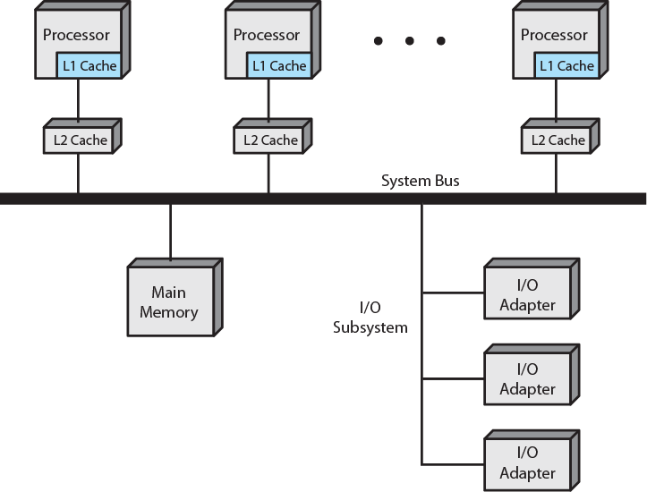
SMP Organization
Figure 1.19 Symmetric Multiprocessor Organization
Notes:
ORGANIZATION Figure 1.19 illustrates the general organization of an SMP.
There are multiple processors, each of which contains its own control unit, arithmetic logic unit, and registers. Each processor has access to a shared main memory and the I/O devices through some form of interconnection mechanism; a shared bus is a common facility. The processors can communicate with each other through memory (messages and status information left in shared address spaces). It may also be possible for processors to exchange signals directly. The memory is often organized so that multiple simultaneous accesses to separate blocks of memory are possible.
In modern computers, processors generally have at least one level of cache memory that is private to the processor. This use of cache introduces some new design considerations. Because each local cache contains an image of a portion of main memory, if a word is altered in one cache, it could conceivably invalidate a word in another cache. To prevent this, the other processors must be alerted that an update has taken place. This problem is known as the cache coherence problem and is typically addressed in hardware rather than by the OS.

Slide 59
Multicore Computer
Also known as a chip multiprocessor
Combines two or more processors (cores) on a single piece of silicon (die)
each core consists of all of the components of an independent processor
In addition, multicore chips also include L2 cache and in some cases L3 cache
Notes:
A multicore computer, also known as a chip multiprocessor , combines two or more processors (called cores) on a single piece of silicon (called a die). Typically, each core consists of all of the components of an independent processor, such as registers, ALU, pipeline hardware, and control unit, plus L1 instruction and data caches. In addition to the multiple cores, contemporary multicore chips also include L2 cache and, in some cases, L3 cache.
The motivation for the development of multicore computers can be summed up as follows. For decades, microprocessor systems have experienced a steady, usually exponential, increase in performance. This is partly due to hardware trends, such as an increase in clock frequency and the ability to put cache memory closer to the processor because of the increasing miniaturization of microcomputer components. Performance has also been improved by the increased complexity of processor design to exploit parallelism in instruction execution and memory access. In brief, designers have come up against practical limits in the ability to achieve greater performance by means of more complex processors. Designers have found
that the best way to improve performance to take advantage of advances in hardware is to put multiple processors and a substantial amount of cache memory on a
single chip. A detailed discussion of the rationale for this trend is beyond our scope, but is summarized in Appendix C .

Slide 60
Intel Core i7
Supports two forms of external communications to other chips:
DDR3 Memory Controller
brings the memory controller for the DDR (double data rate) main memory onto the chip
with the memory controller on the chip the Front Side Bus is eliminated
enables high-speed communications among connected processor chips
QuickPath Interconnect (QPI)
Notes:
An example of a multicore system is the Intel Core i7, which includes four x86 processors, each with a dedicated L2 cache, and with a shared L3 cache ( Figure 1.20 ). One mechanism Intel uses to make its caches more effective is prefetching, in which the hardware examines memory access patterns and attempts to fill the caches speculatively with data that’s likely to be requested soon.

Slide 61
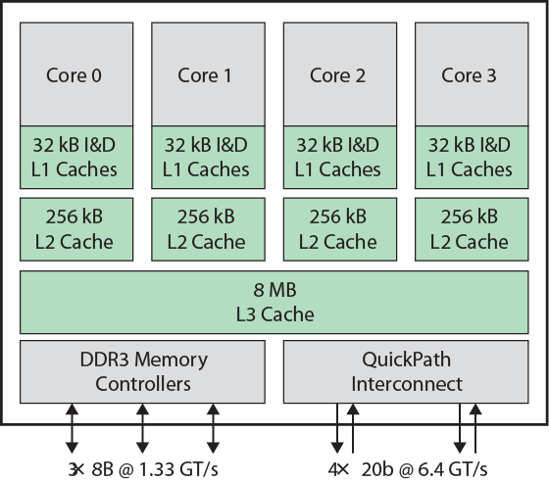
Intel Core i7
Figure 1.20 Intel Corei7 Block Diagram
Notes:
The Core i7 chip supports two forms of external communications to other chips. The DDR3 memory controller brings the memory controller for the DDR (double data rate) main memory onto the chip. The interface supports three channels that are 8 bytes wide for a total bus width of 192 bits, for an aggregate data rate of up to 32 GB/s. With the memory controller on the chip, the Front Side Bus is eliminated. The QuickPath Interconnect (QPI) is a point-to-point link electrical interconnect specification. It enables high-speed communications among connected processor chips. The QPI link operates at 6.4 GT/s (transfers per second).

Slide 62
Summary
Basic Elements
processor, main memory, I/O modules, system bus
GPUs, SIMD, DSPs, SoC
Instruction execution
processor-memory, processor-I/O, data processing, control
Interrupt/Interrupt Processing
Memory Hierarchy
Cache/cache principles and designs
Multiprocessor/multicore
Notes:
Summary of Chapter 1.

